Slide 1

Final Project Presentation
Group 4
Members:
· Fang Chongyu A0825314E
· Fan Xiuqi A0285060J
· Wang Sijie A0284859E
· Chen Ziao A0285086U
· Zhou Tingguang A0285076W
· Lyu Zhengwen A0285247W
Supervisor：Prof. Marcelo
Session 2023/2024
09 Apr 2024
Github Link：LandoFan/ME5413_Final_Project: NUS ME5413 Autonomous Mobile Robotics Final Project (github.com)

Slide 2

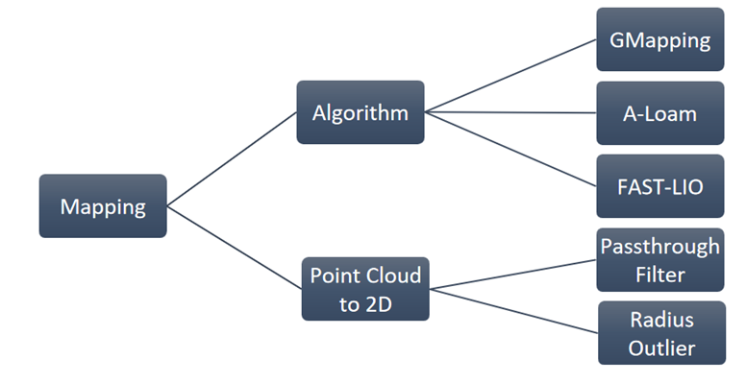
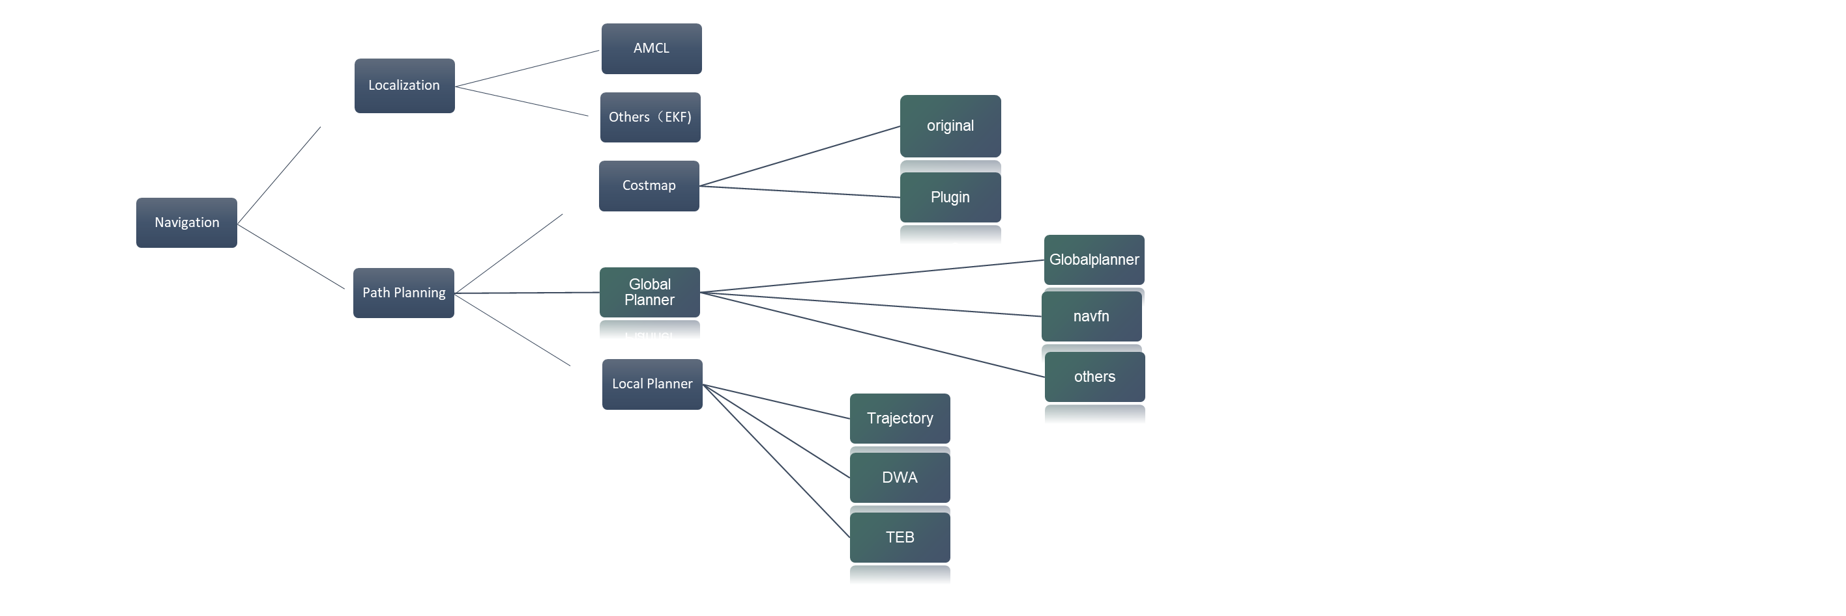
How to accomplish this task?

Slide 3
2.1 Mapping
· Gmapping
· A-Loam
· Fast Lio
2.2 Point cloud to 2D-Map
· The PassThrough Filter
· The Radius Outlier Removal
2.3 Results and Discussion
Part 1——Mapping
Contents

Slide 4
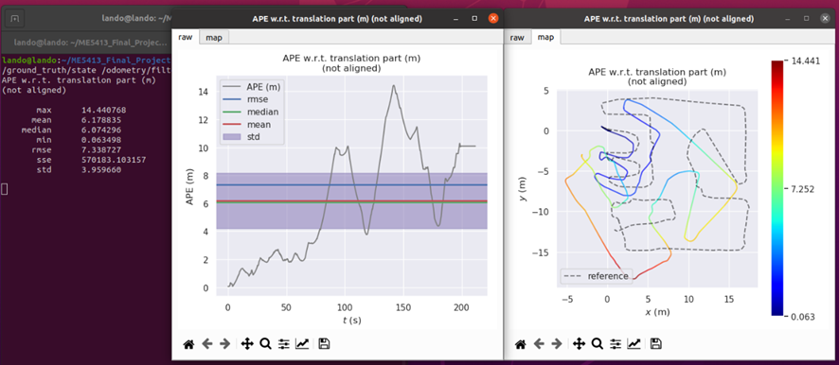
Mapping——GMapping
The error of the map by GMapping
Introduction：
2D SLAM algorithm
Apply in small scenes
Require more calculations
Mean:6.17
Rmes:7.33
STD:3.96
Focus on the curves and colored lines
Conclusion: 2D SLAM algorithm: GMapping is not suitable for this task

Slide 5
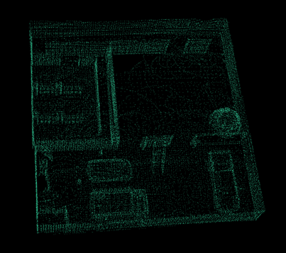
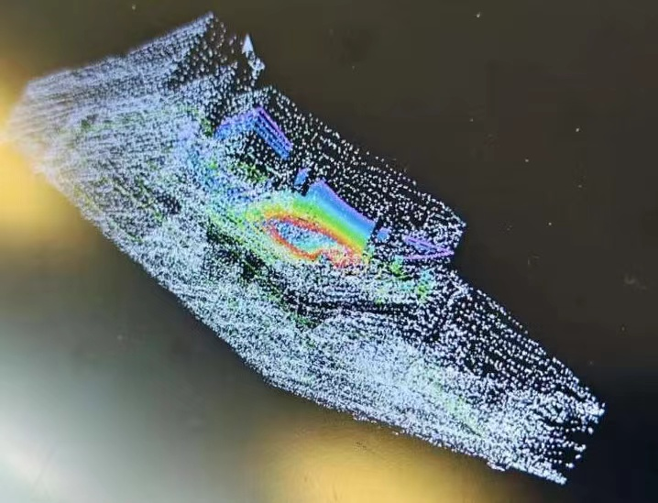
Mapping——A-Loam
Point Cloud view from above
Introduction：
A-Loam (Adaptive Lidar Odometry and Mapping) is an enhanced version of Loam (Lidar Odometry and Mapping), which is a system for real-time three-dimensional mapping and localization.
Overturn
Point Cloud view from below
There was an obvious upturn in Assembly lines!

Slide 6
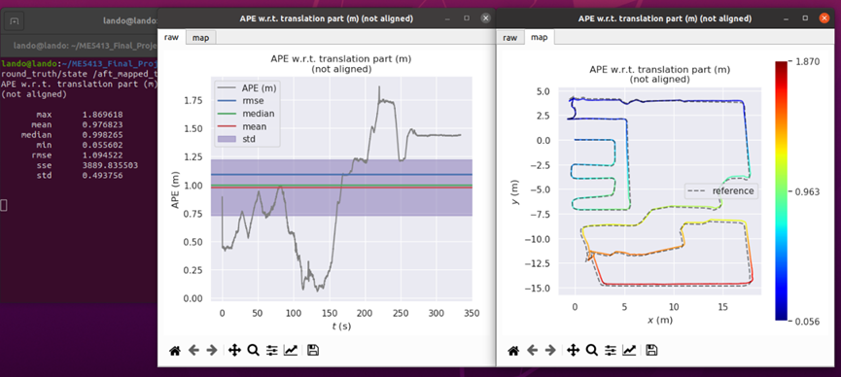
Mapping——A-Loam
The error of the map by A-Loam
Mean:0.97
Rmes:1.09
STD:0.49
Conclusion: A-Loam is a feasible method and still has room for improvement
Notes:
1.After building the ‘ME5413_Final_Project’ and A-Loam, the A-Loam is moved into ‘ME5413_Final_Project/src’ folder as a package in the repo whose name is ‘A-LOAM’. Then build the Octomap as an auxiliary means and move it into ‘ME5413_Final_Project/src’ in same way. Compile the entire project package simultaneously using the ‘catkin_make’ command.
2.Write the ‘aloam.launch’ file and take care to rewrite the value to 32 and change the value in ‘accessories.urdf.xacro’, which is in the jackal-description file, set it to HDL32E.Means A-Loam will use HDL-32E for higher accuracy scanning.
3.Run two different roslaunch commands from two terminals: ‘roslaunch me5413_Final_Project me5413_project.world’ and ‘roslaunch A-LOAM octomap.Launch’, which is used to simulate the startup world and the auxiliary tool Octomap. After generating the map, select ‘Octomap’ in the options to observe the auxiliary 2D map.
4.Run a roslaunch command from the terminal under the ‘A-LOAM/launch’ folder: ‘roslaunch aloam.launch’, which is used to start the A-Loam location & Mapping task. Respectively using ‘U’, ‘I’, ‘O’, ‘M’, ‘,’, ‘.’ to control the forward, backward, and direction of the trolley, and sample the point cloud of the entire map.
5.The generated .pcd file and .bag file are located in the home directory folder.

Slide 7
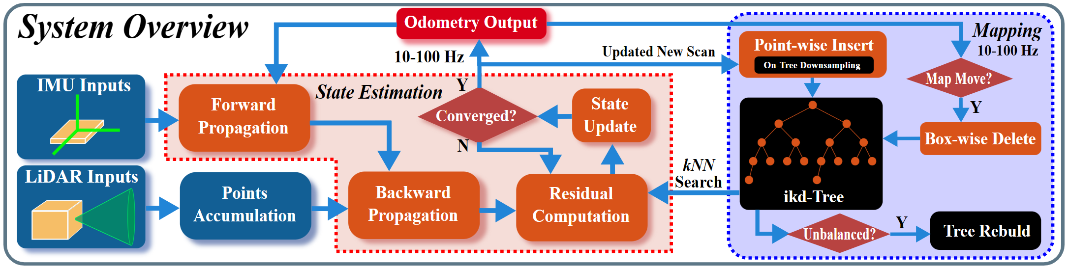
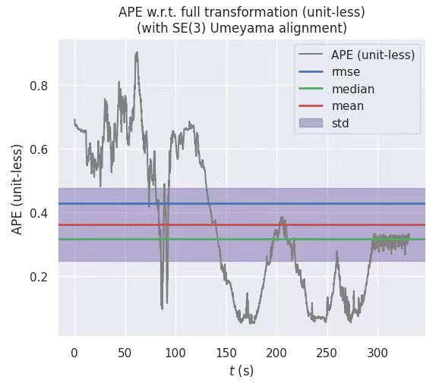
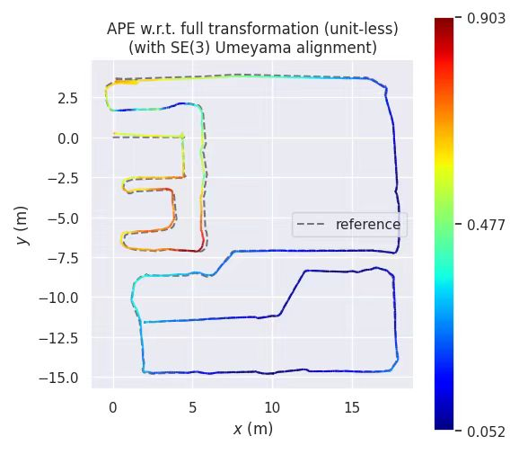
Mapping——Fast Lio
Fast-Lio, a fast and robust Lidar-Inertial Odometry (LIO) package designed to achieve high-precision, low-latency real-time 3D positioning and mapping proposed by the MARS Laboratory at the University of Hong Kong.
Real-time Performance
High Precision and Robustness
Low Latency
System Overview of Fast-Lio
Mean: 0.36
Rmse: 0.43
Std: 0.23
Error of Fast-Lio

Slide 8
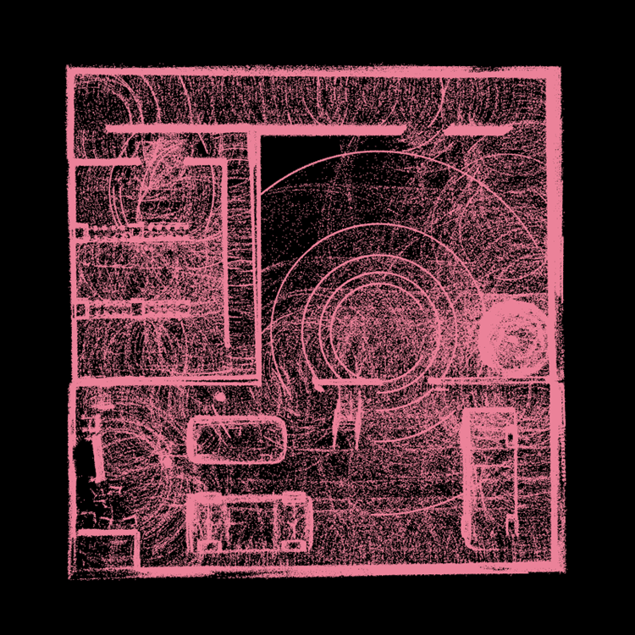
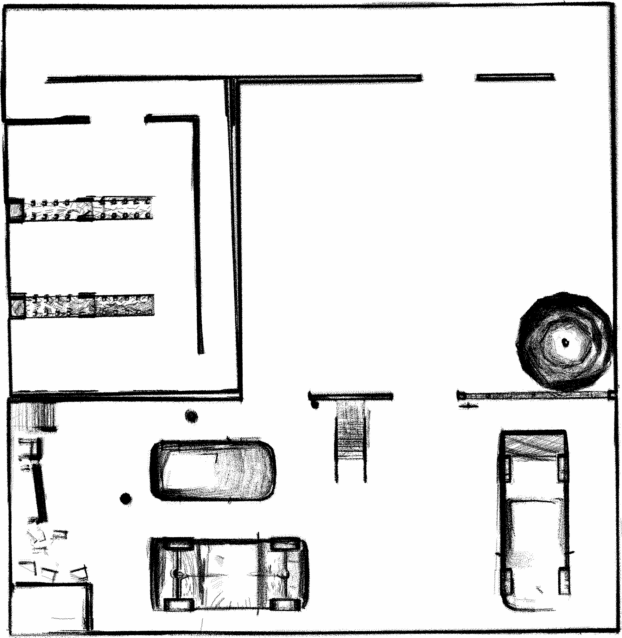
Mapping——Point cloud to 2D-Map
· The PassThrough Filter
Select the desired point cloud by setting the threshold for the Z-axis.
· The Radius Outlier Removal
Determine whether to keep the point according to local neighborhood information.
Point cloud generated by Fast-Lio
Converted map

Slide 9
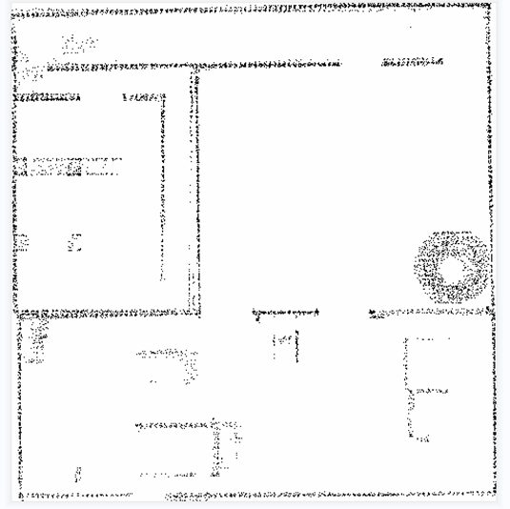
Mapping——Results and Discussion
In the map of A-Loam, some noises are in the same plane as the wall or cars, making it hard to separated them.
In the map of Fast-Lio, the noise can be separated easily by selecting the outer thresholds.
The error of Fast-Lio is significantly less than the other two algorithms.
A-Loam
Fast-Lio
 | Gmapping | A-Loam | Fast-Lio
Mean | 6.17 | 0.97 | 0.36
Rmse | 7.33 | 1.09 | 0.43
Std | 3.96 | 0.49 | 0.23

Slide 10
2.1 Localization
· AMCL
2.2 Path Planning
· Costmap
· Planning
Local planning——TEB
Global planning——Global planner
· Navigate to ‘1’ in random boxes
· Specific operation process
2.3 Results and Discussion
Part 2——Navigation
Contents

Slide 11
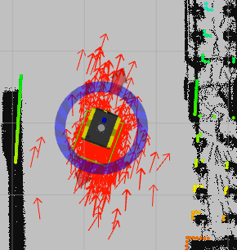
Navigation——Localization
· AMCL
·Particle filtering
·Initial particle and weight
·Update weight and resample
·Estimate probable location

Slide 12
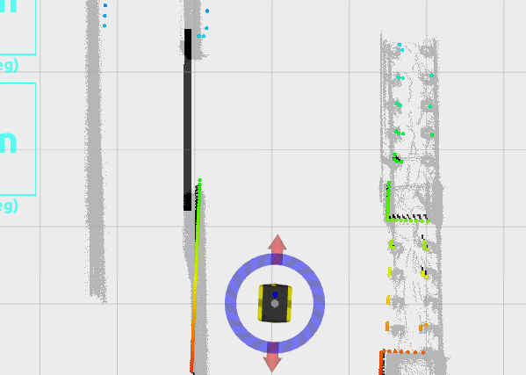
Navigation——Path Planning
Static layer
Obstacle layer
Inflation layer
Prohibition layer
Global Costmap
· Costmap
Local cost map for local planner
Global cosmap for global planner
Composed of multiple layers
Layers
Static Map Layer：static map constructed by SLAM.
Obstacle Map Layer：obstacle map detected by sensors, for example lidar.
Inflation Layer：outward expansion area from each other layers, collision prevention.
Other Layers：customized shaped costmap
Static layer
Obstacle layer
Inflation layer
Prohibition layer
Local Costmap
(Prohibition Layer)
12

Slide 13
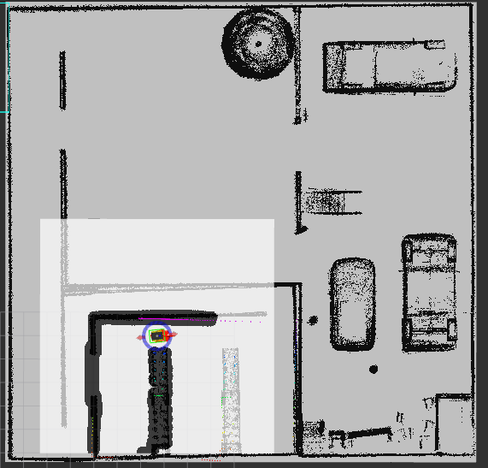
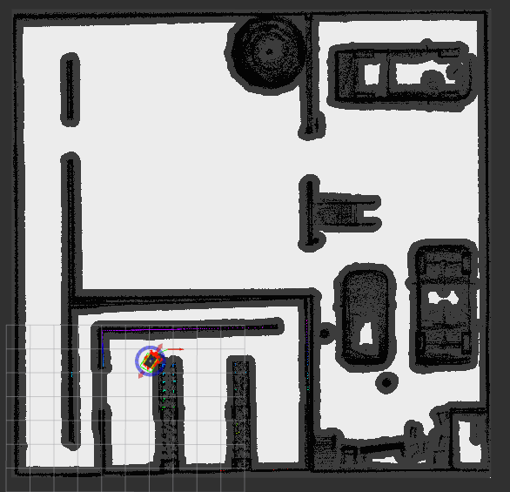
Navigation——Path Planning
· Local costmap and Global cosmap
Local costmap
Global costmap

Slide 14
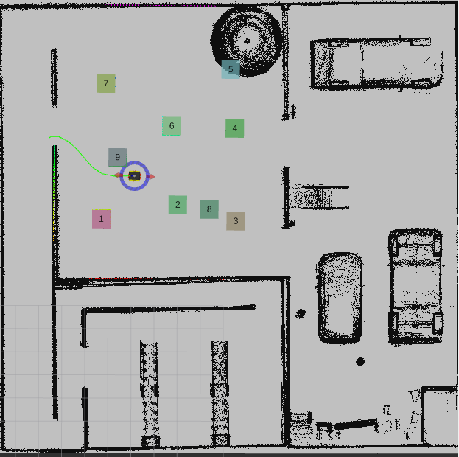
Navigation——Path Planning
· Local planning——TEB method
· Using an elastic band to represent the robot's trajectory
· A time parameterization method is used to represent the trajectory
· TEB is implemented as one of the local planners in the move_base node in ROS

Slide 15
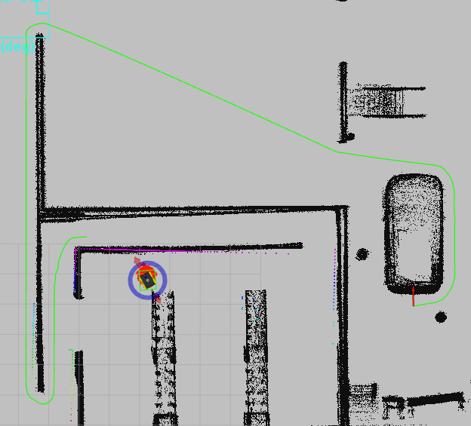
Navigation——Path Planning
· Global planning——Global planner
· Global Planner provides an interface that can integrate different path planning algorithms according to user needs, such as the A* algorithm or Dijkstra algorithm
· Navfn or global_planner?
move_base.launch
Navfn always fail to generate full path!

Slide 16
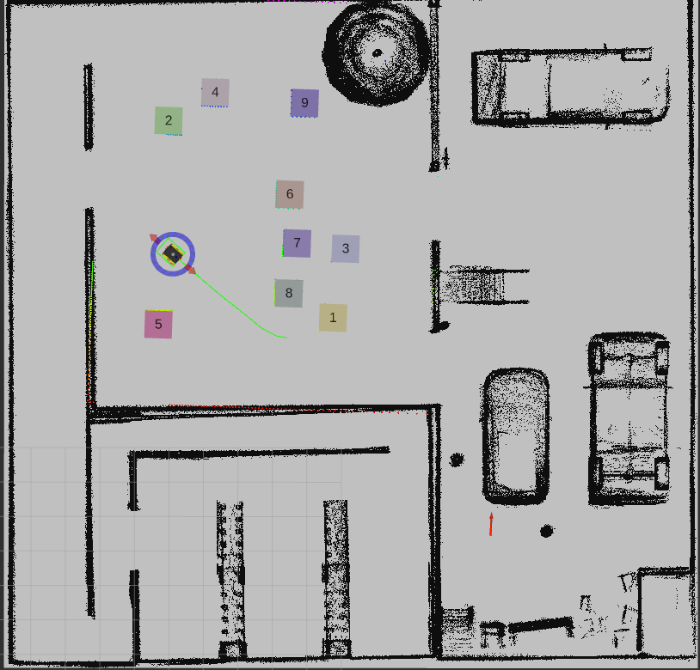
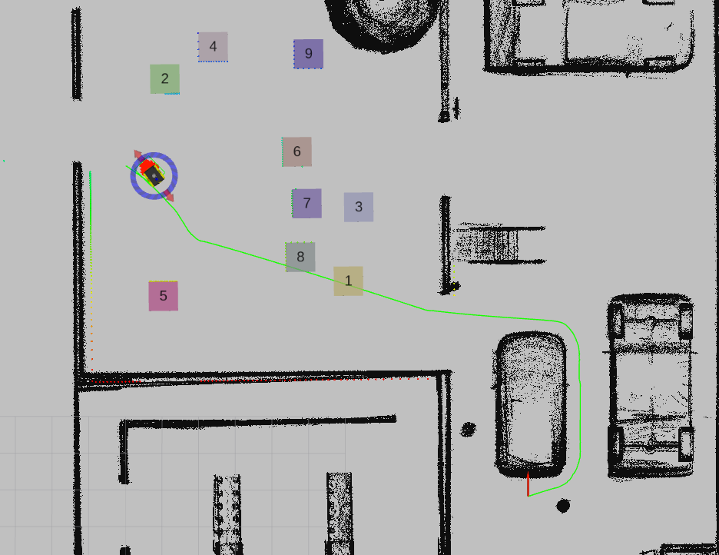
Navigation——Path Planning
· Global planning and local planner
Global planner
Local planner

Slide 17
Navigation——Path Planning
· Collaborative effort between TEB and Global Planner
· Based on the collaborative effort, the Global planner and TEB together ensure effective navigation of the robot in complex and variable environments
· The TEB continuously evaluates and adjusts the robot's speed and direction to optimize travel efficiency and safety
· If the robot encounters large-scale obstacles or blockages that cannot be resolved through simple local adjustments, the Global Planner can be reactivated to update the path to circumvent the obstacle
· The Global Planner provides macro-level navigational guidance, while the TEB is responsible for micro-level path adjustments and optimizations

Slide 18
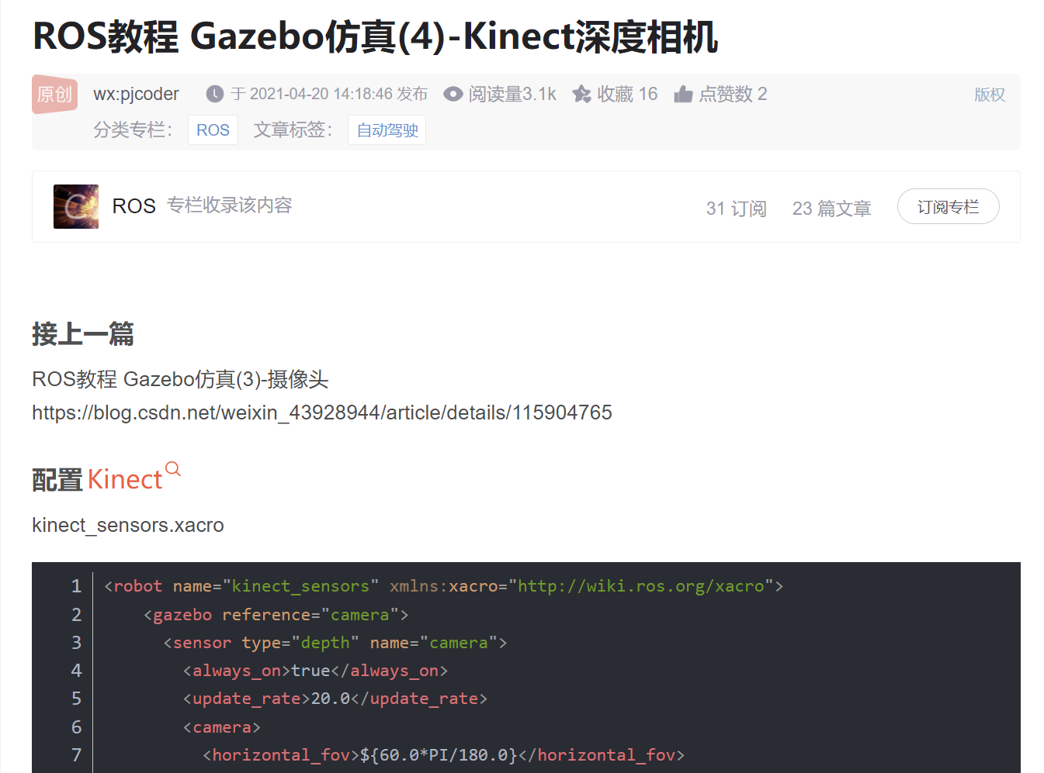
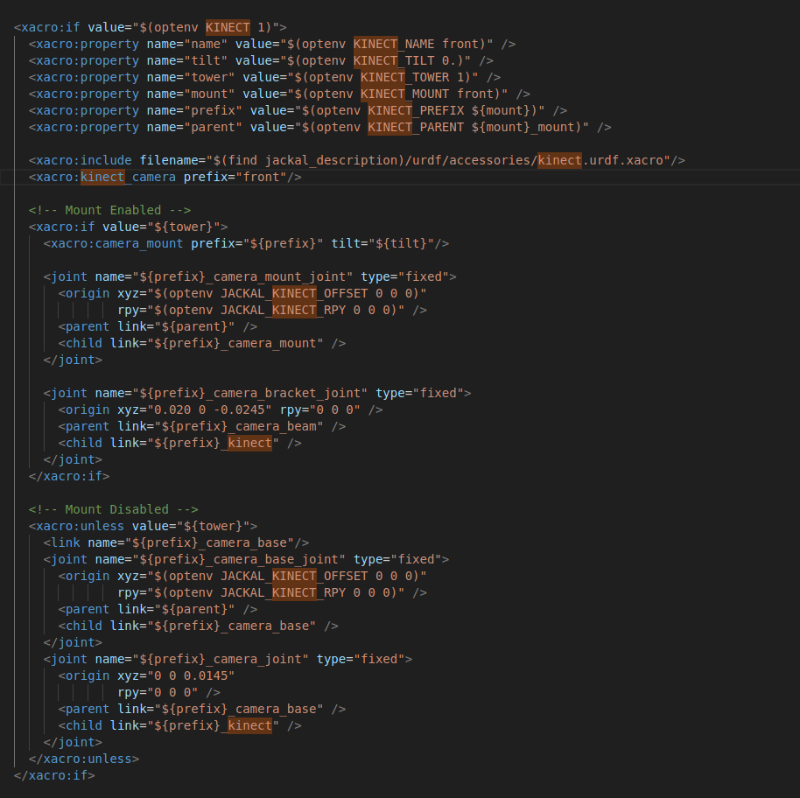
Navigation——Camera Configuration
· Replace original camera to kinect camera
add kinect.dae to /src/jackal_description/meshes/
and
add kinect.urdf.xacro to src/jackal_description/urdf/accessories/
switch the camera by modify
/src/jackal_description/urdf/accessories.urdf.xacroect.
<xacro:if value="$(optenv JACKAL_FLEA3 0)">
<xacro:if value="$(optenv KINECT 1)">
https://blog.csdn.net/weixin_43928944/article/details/115905084
https://blog.csdn.net/m0_56588389/article/details/121043489

Slide 19
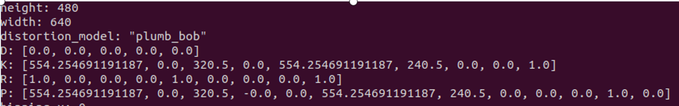

Navigation——Box Coordinates Calculation
· Obtaining camera internal parameters and depth
Subscribe to the topic /front/rgb/camera_info to obtain Internal parameters
And /front/depth/image_raw to depth
Assume center point of the matching frame(center.x,center.y) as the position of the box.
Calculate the position of the center point in the camera coordinate system
Convert to world coordinate system by tf.TransformListener()
Set a barrier distance on Z

Slide 20
Navigation——Path Planning
· Navigate to ‘1’ in random boxes
Some virtual goal positions have been specified in the box area and we randomize one of these targets move to that point.
Implementing template matching to lock on target box during the process to the random target.
If the target box was found, then terminate current action and reset the goal as heading toward the coordinates of the box calculated from the camera depth and internal parameters.
If the target box could not be found on the path, we click the button 1 again to renew the virtual goal positions.
Loop until finally navigate to the box No.1.

Slide 21


Navigation——Path Planning
· Navigate to ‘1’ in random boxes Vision Problem
Template matching matches the original image to the detected image;
Have certain demands of the original image, based on the gazebo environment, we generate a figure 1 and turn it into gray level to realize template matching.
We tried the binary image, but it will regard the wall as the success of the template matching.

Slide 22
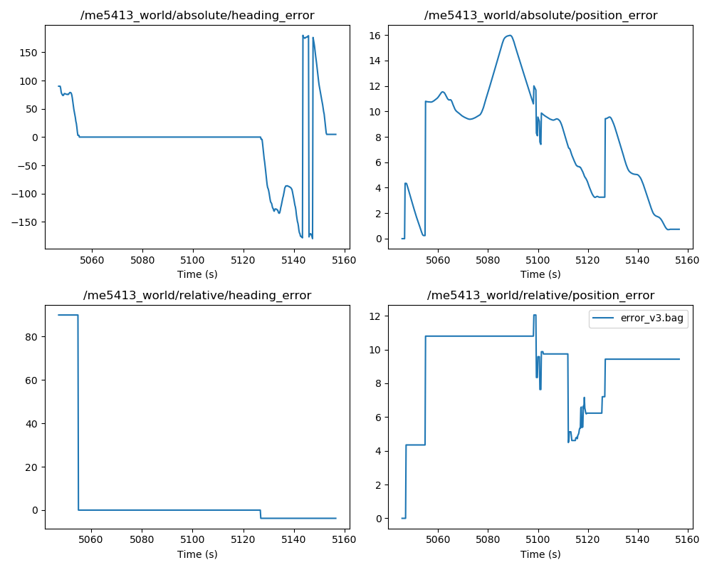
Navigation——Results and Discussion
The results of the navigation are shown in the Figure.
Since the heading error is related to the target goal heading, the heading error just shows the rotation of the agents in the direction to the target point.
The reason why there is a period of 0 in the middle of the runtime is that when the agent moves towards the box, no certain position is published. The absolute position error is 0 at last, meaning that the agent arrives at the final goal.

Slide 23
Results and Discussion
· Random Boxes Problems
When the agent goes to the box 1, the explicit location of the box is unknown. Thus, a virtual goal must be set to enable the agent to go to this goal. On the way to this goal, if the agent can see the box 1, the template matching works and publish a new goal, which is the location of the box acquired by the vision, driving the agent reaches the box 1. However, if the agent cannot see the target box, the vision cannot work. We can just randomize the location until the agent can see the box 1 on the path.
Thus, we select a few virtual locations at first. After the box locations are set, we click the button ‘box 1’ to enable the agent to go to the virtual location, which is located at the same time when clicking. A global planning path can be set. The virtual location can be renewed by clicking the button again if the agent cannot see the target box on the global planning path. By looping this process, the agent can get access to the target box definitely.

Slide 24
Further Improvement
Not totally correct location:
After the agent finds the target box, a new target goal is set based on the depth calculation in the file ‘camera_calculation.py’. However, this calculation is not quite correct. The position of the final goal sometimes cannot quite near the box.

Slide 25
Further Improvement
Drift problem :
To solve the drift problem, simultaneous utilization of AMCL and EKF is an effective strategy.
Running both EKF and AMCL concurrently allows the two filters to independently update states. The weights of the outputs from EKF and AMCL are dynamically adjusted based on environmental features and the reliability of sensors.
This leverages the continuous localization advantage of EKF to handle high-frequency update demands, while using the environmental matching strength of AMCL for regular corrections to counteract the cumulative errors in EKF.

Slide 26
Reference
https://github.com/hku-mars/FAST_LIO
https://github.com/nuslde/aloam_lidar_odom_result_generate
http://wiki.ros.org/costmap_2d#Occupied.2C_Free.2C_and_Unknown_Space
https://blog.csdn.net/weixin_43928944/article/details/115905084
https://blog.csdn.net/m0_56588389/article/details/121043489
Zheng K. Ros navigation tuning guide[J]. Robot Operating System (ROS) The Complete Reference (Volume 6), 2021: 197-226.
https://wiki.ros.org/navigation/Tutorials/Navigation%20Tuning%20Guide

Slide 27
END
THANK YOU FOR LISTENING
Final Project Presentation

